Slide 1
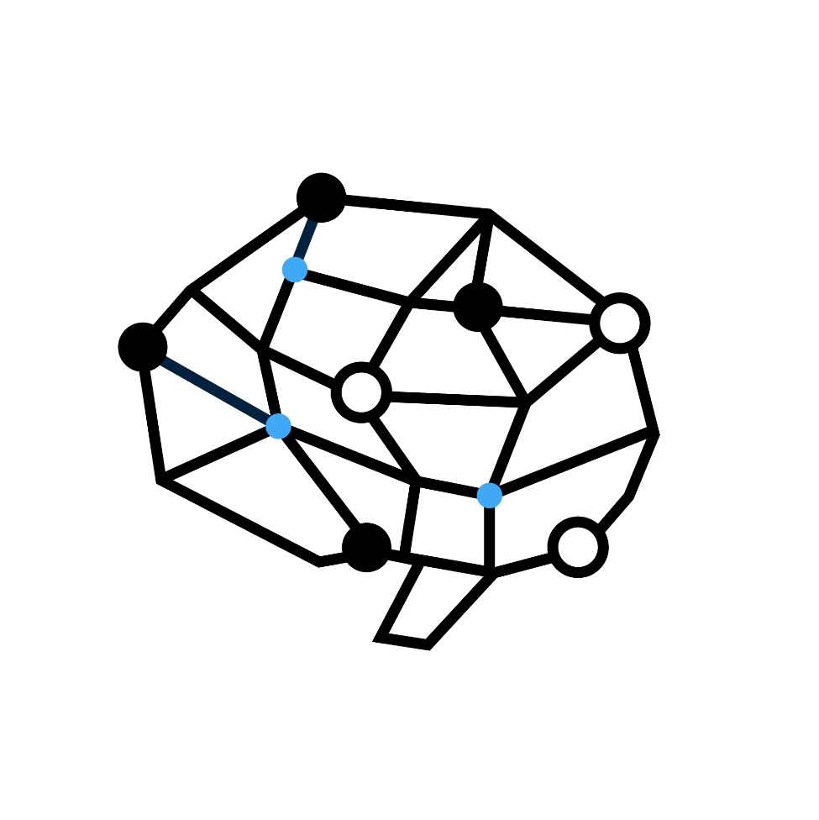




Chap. 5 Game Playing
教育部課程改進計畫
人工智慧技術與應用 - 最先進之電腦對局遊戲系統設計
課程：人工智慧導論
授課教師：顏士淨

Slide 2

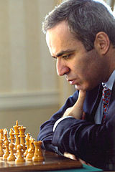
DeepBlue
Deep Blue
Kasparov

Slide 3
Outline
Games vs. search problems
Minimax tree
Alpha-Beta search
Game of chance
Games of imperfect information
Solving games

Slide 4
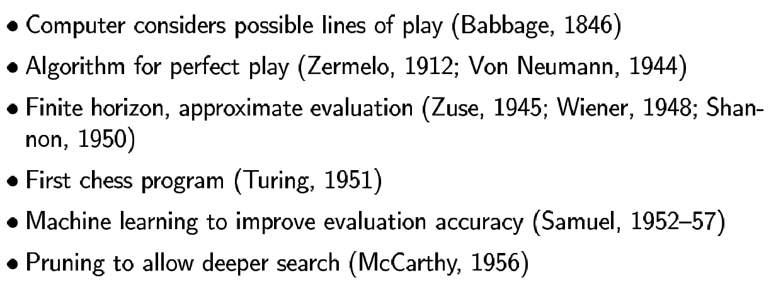
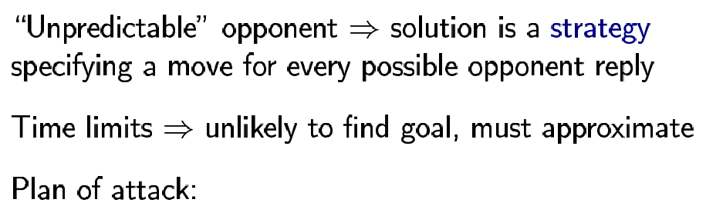
Games vs. search problems

Slide 5
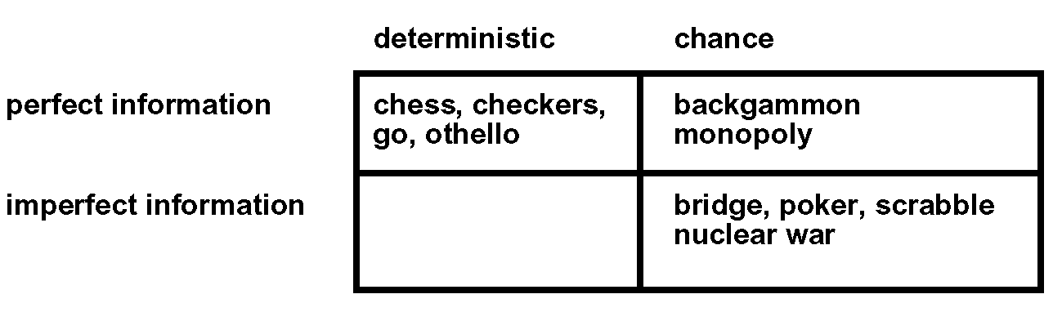
Types of games

Slide 6
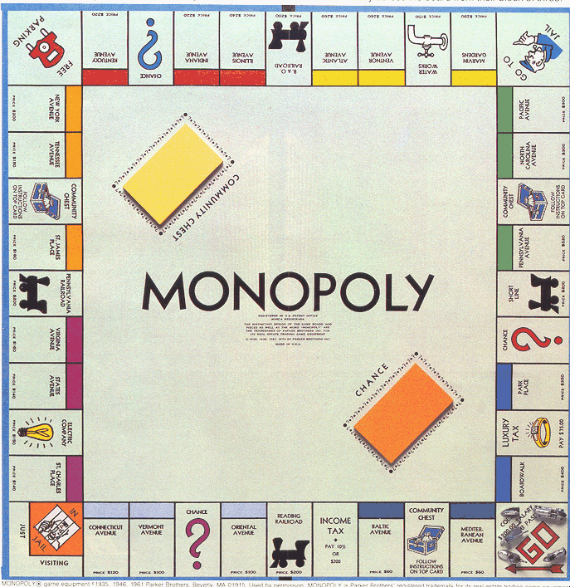

Slide 7
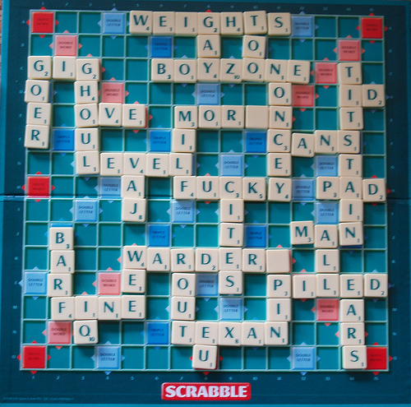

Slide 8
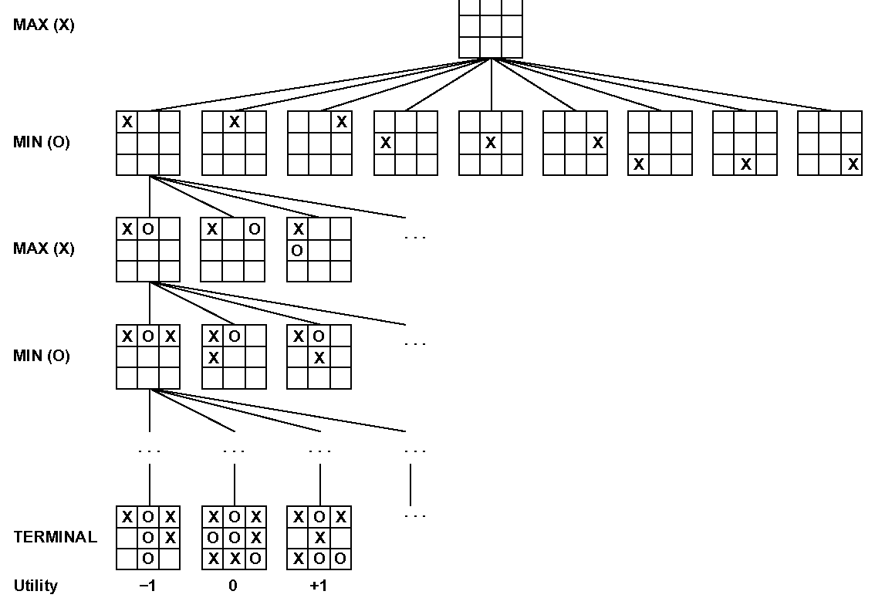
Game tree of Tic-Tac-Toe (2-player, deterministic, turns)

Slide 9
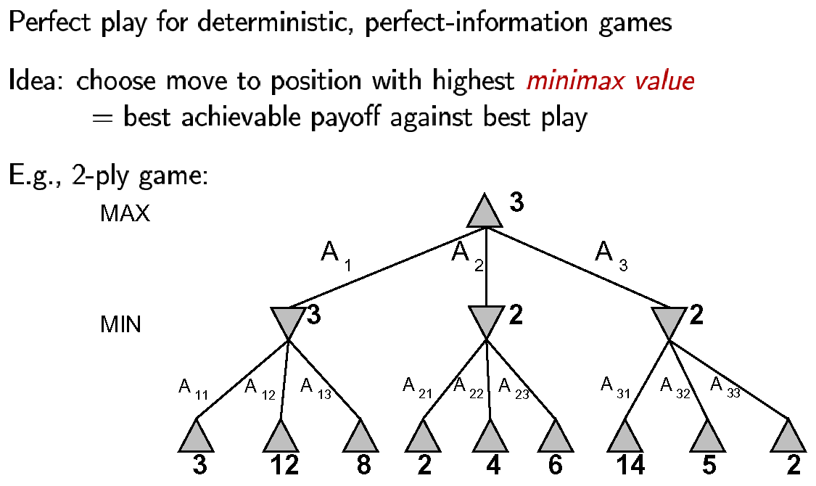
Minimax

Slide 10
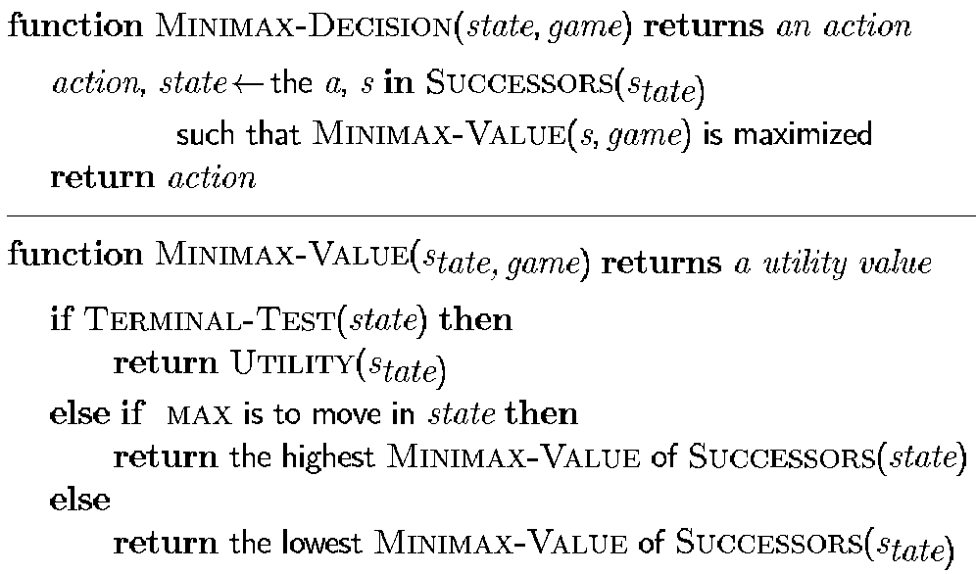
Minimax algorithm

Slide 11
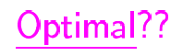
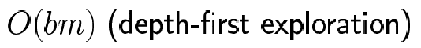
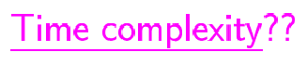
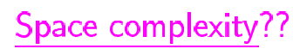
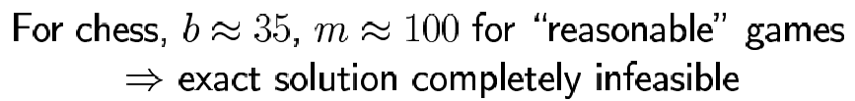
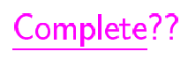
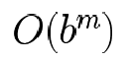
Analysis

Slide 12
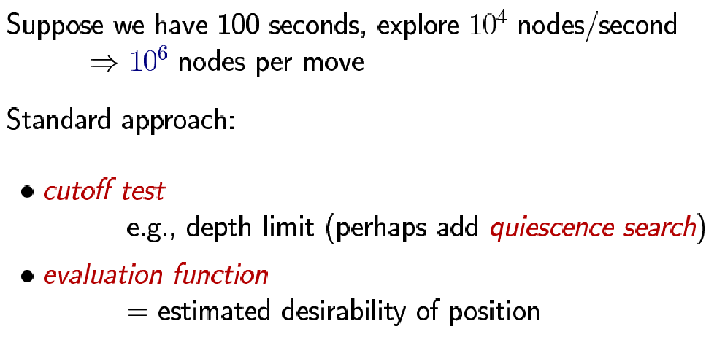
Resource limits

Slide 13
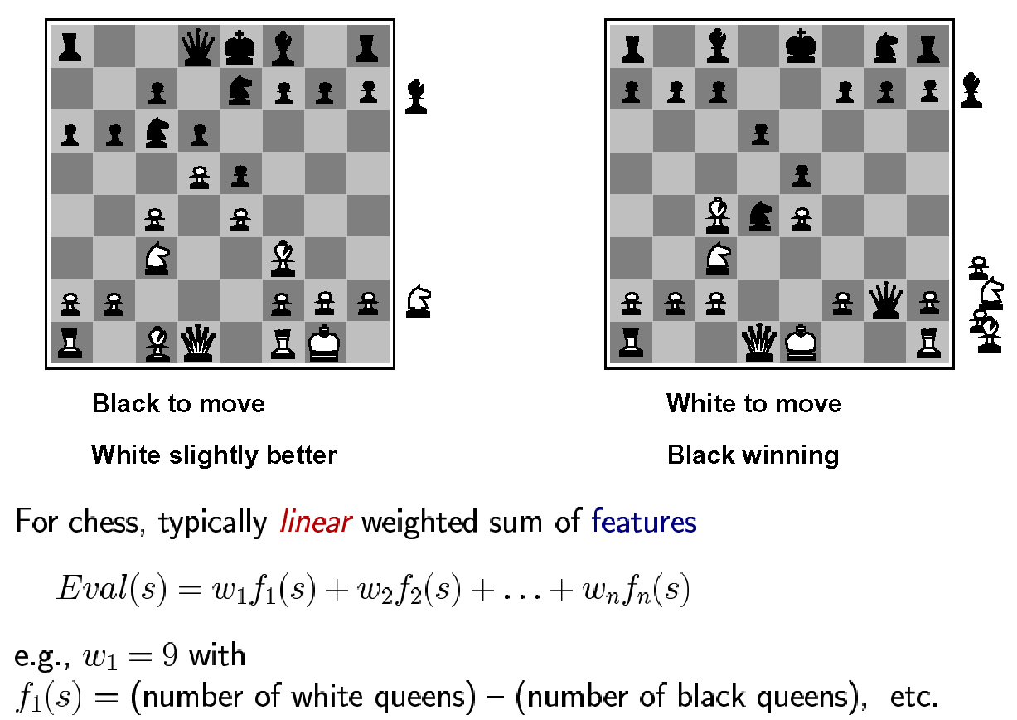
Evaluation functions

Slide 14
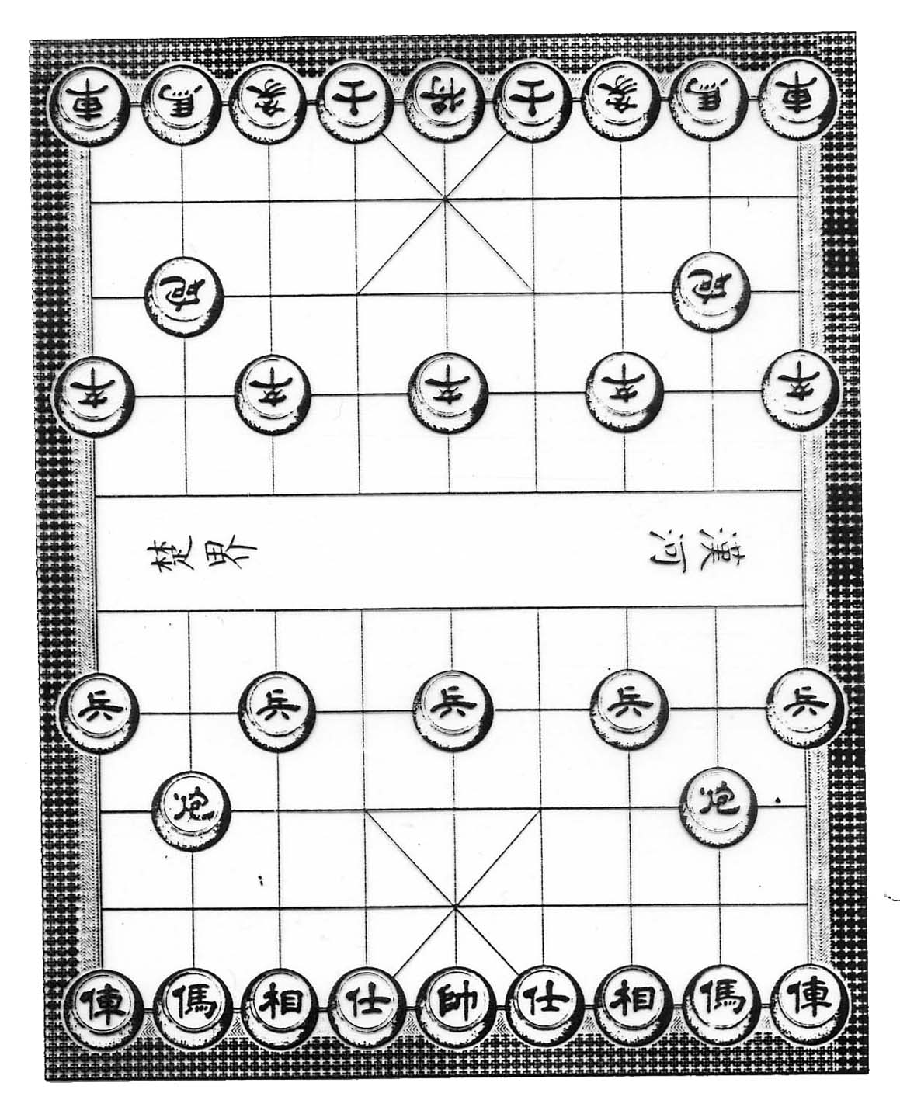
子力
位置

Slide 15
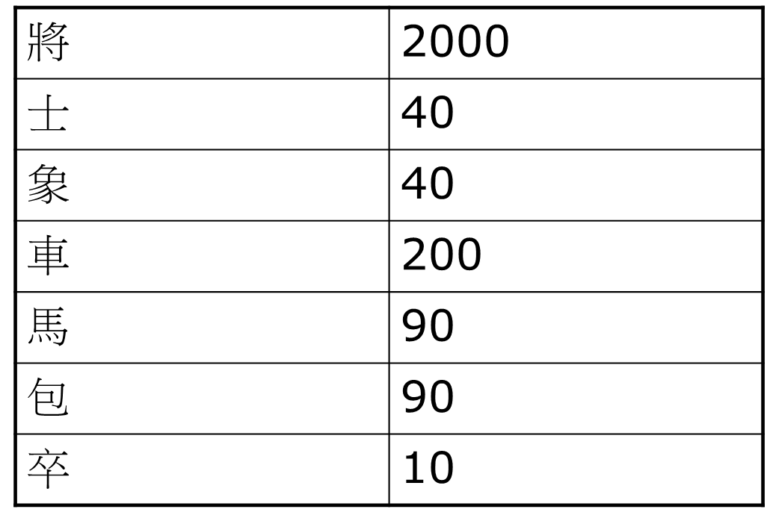
子力

Slide 16
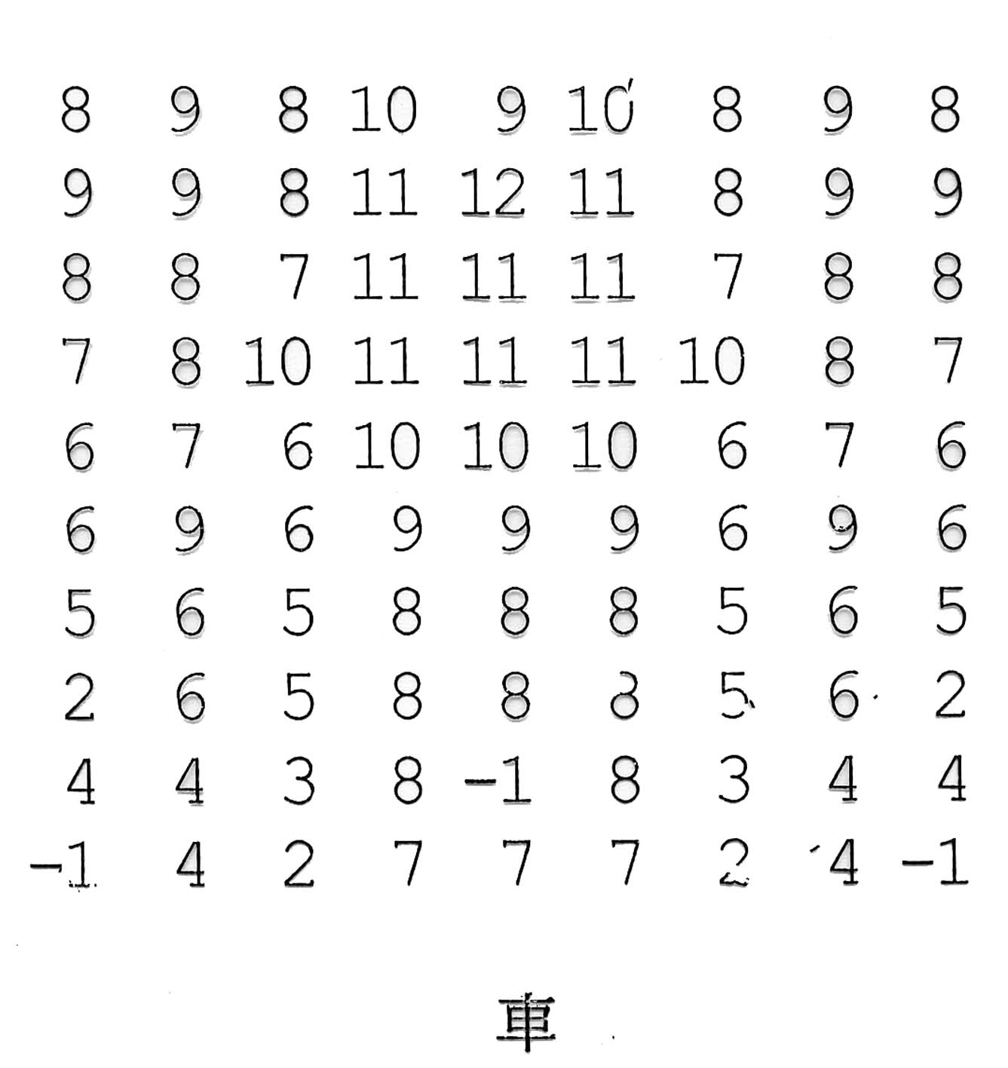

Slide 17
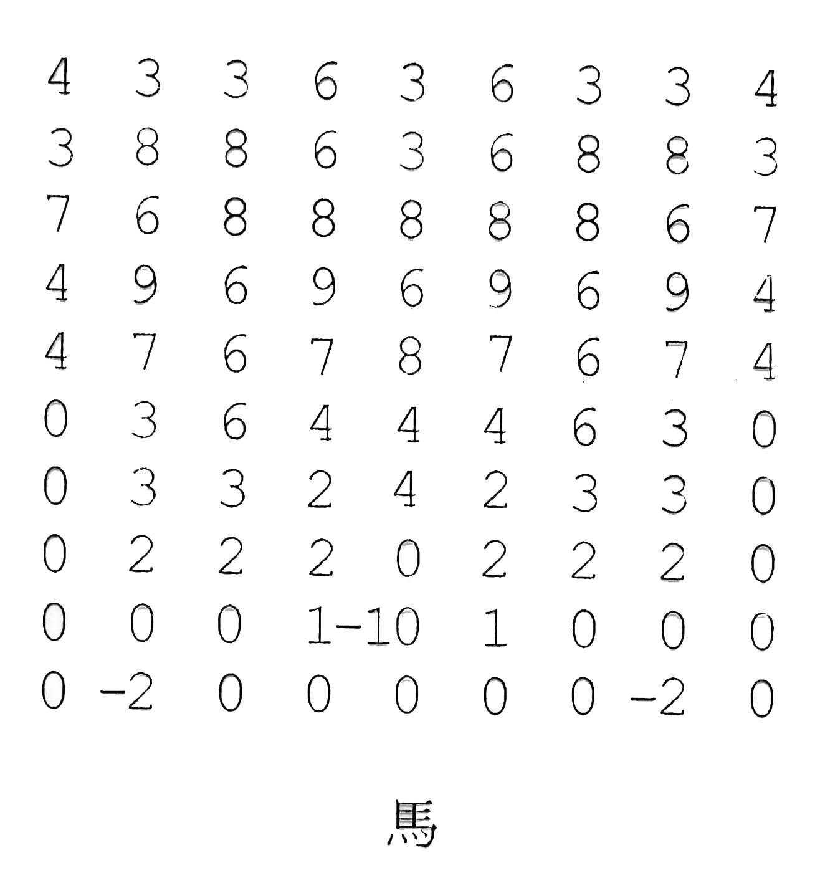

Slide 18
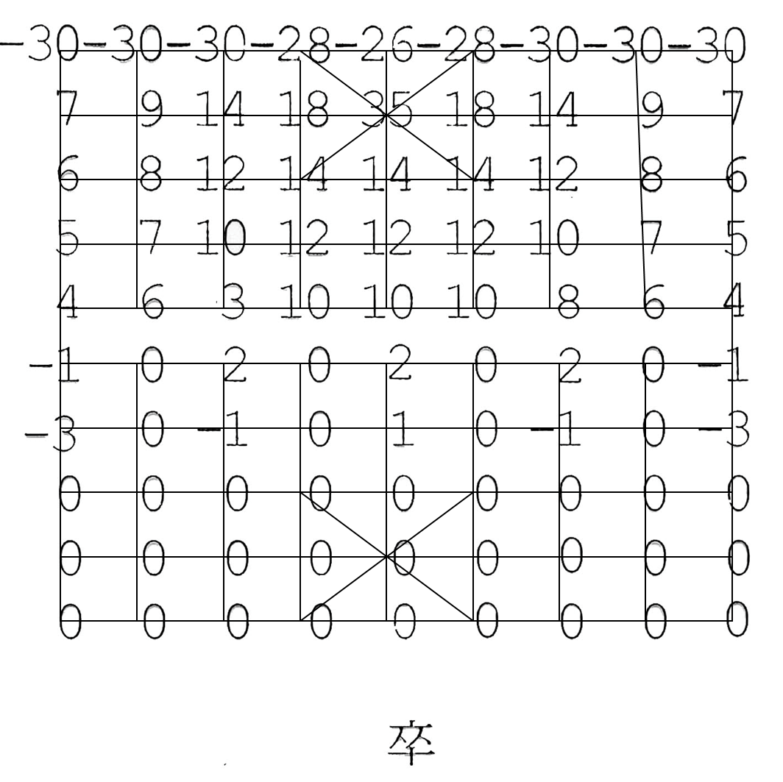

Slide 19
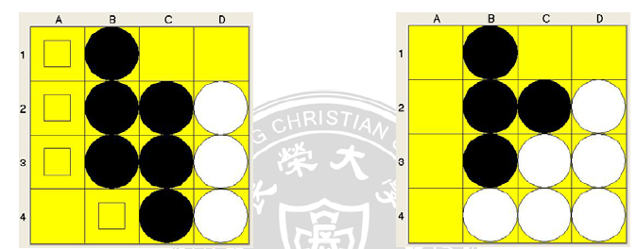
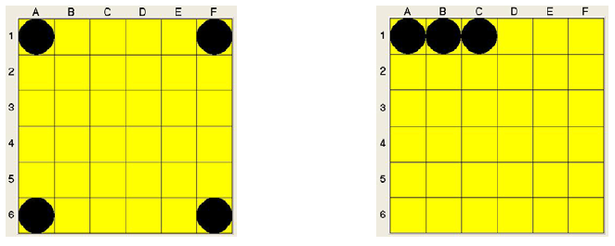
Othello
最多子(Maximum Pieces)
位置權重(Weighted Square)
行動能力(Mobility Consideration)
穩定子(Stability Pieces)

Slide 20
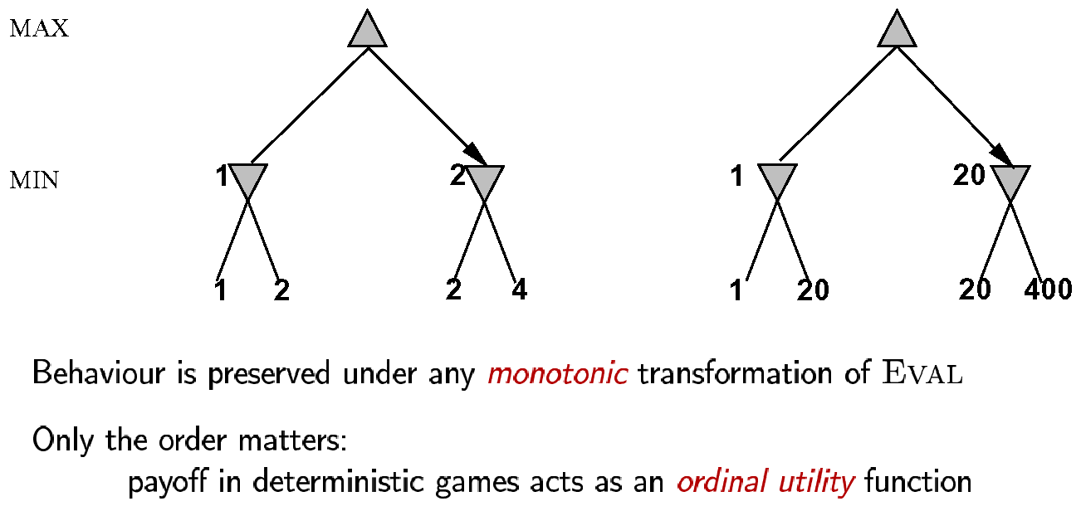
Digression: Exact values don’t matter

Slide 21
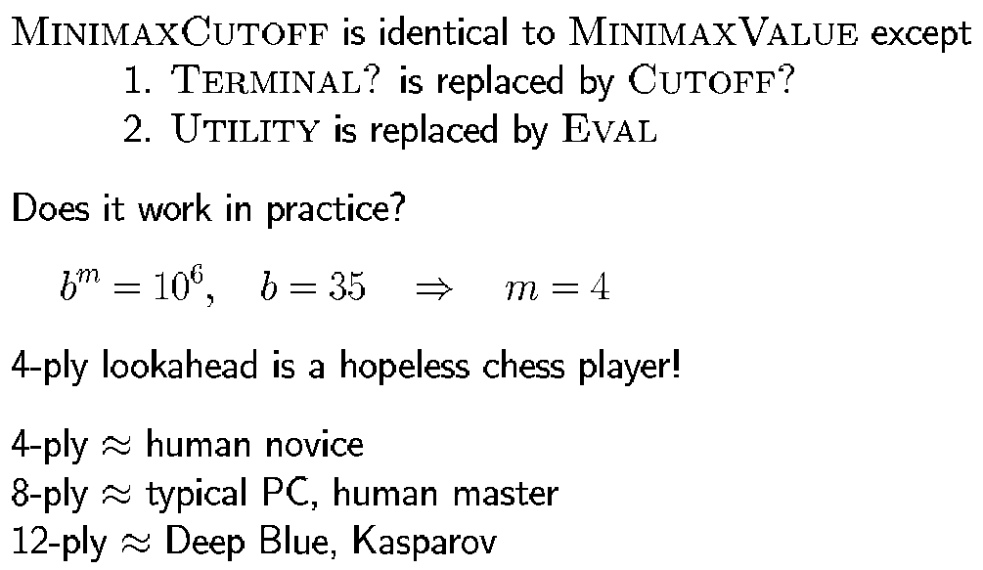
Cutting off search

Slide 22
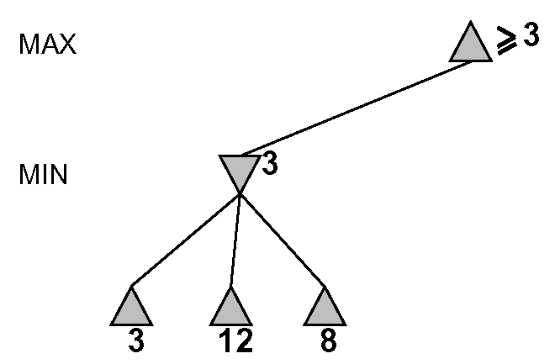

Slide 23
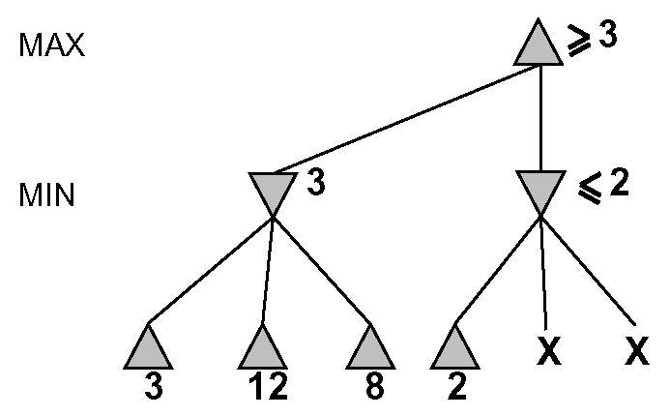

Slide 24
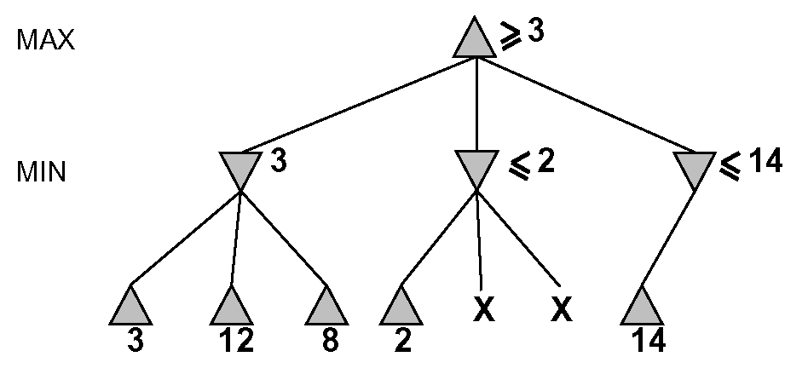

Slide 25
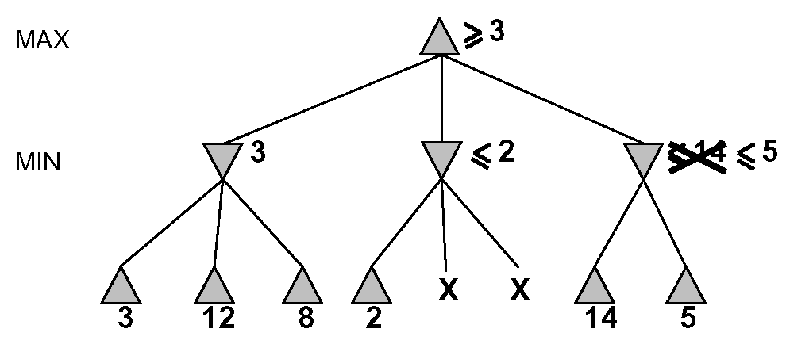

Slide 26
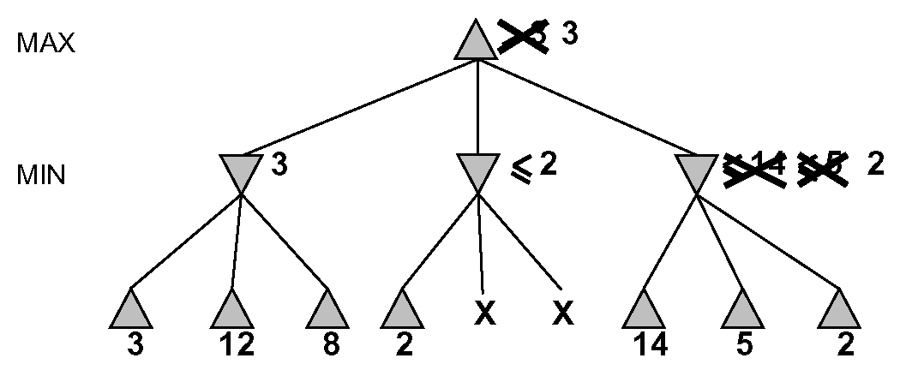

Slide 27
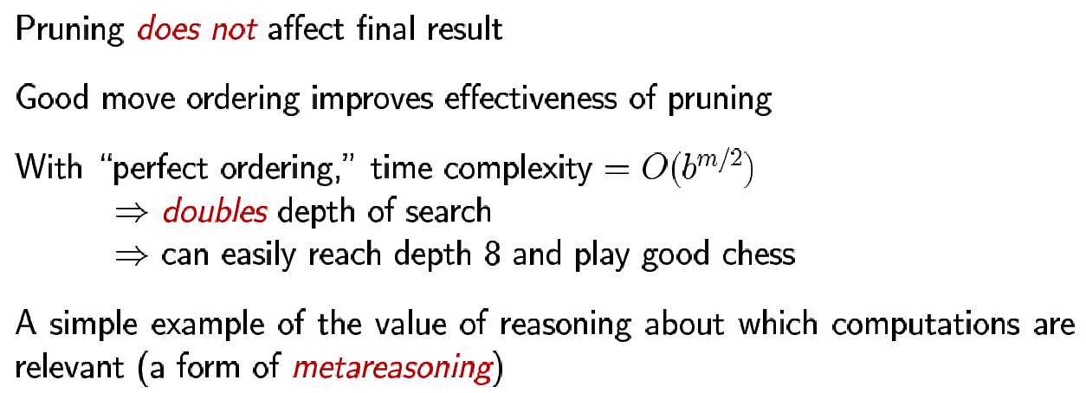
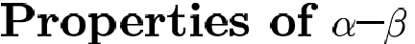

Slide 28
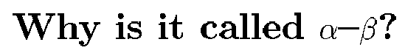
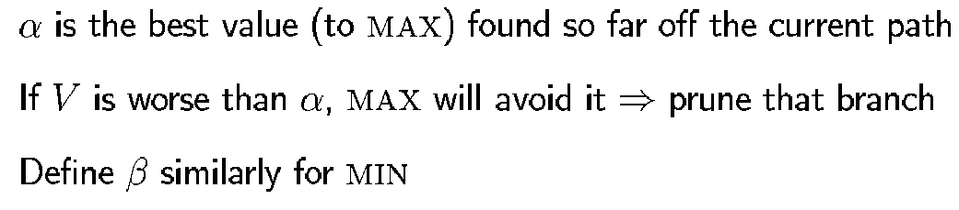
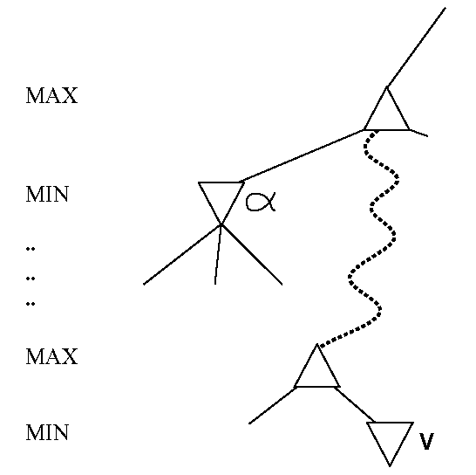

Slide 29
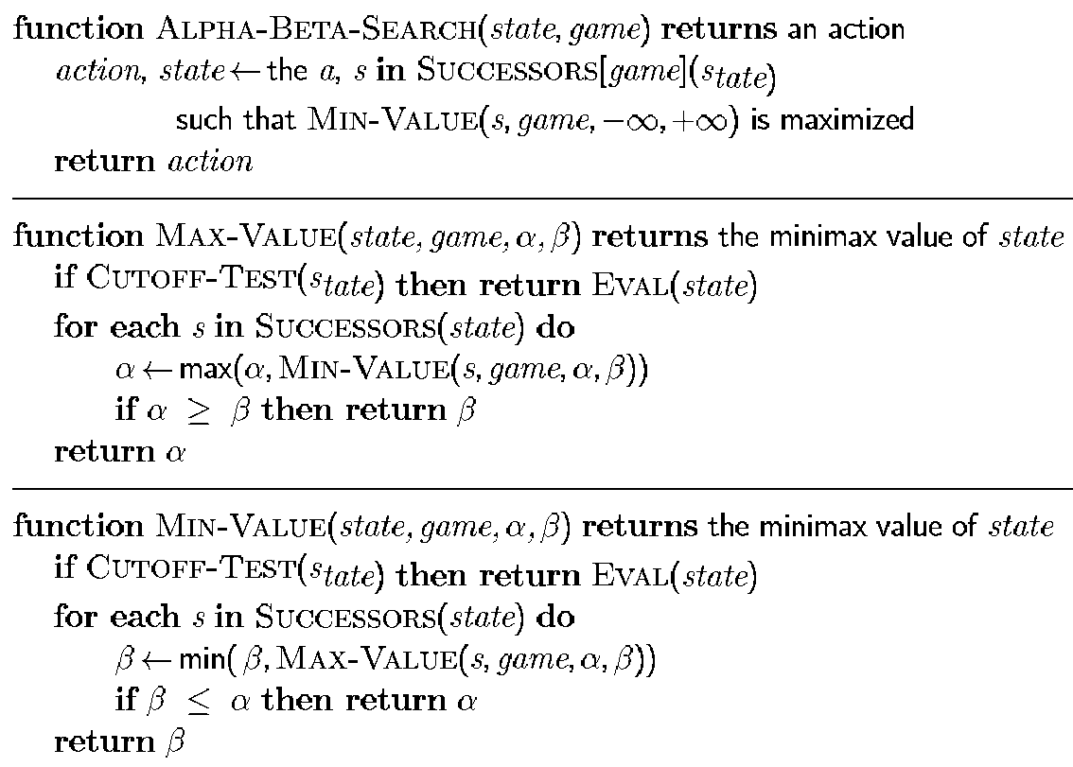
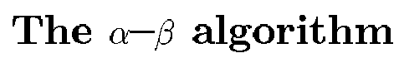

Slide 30
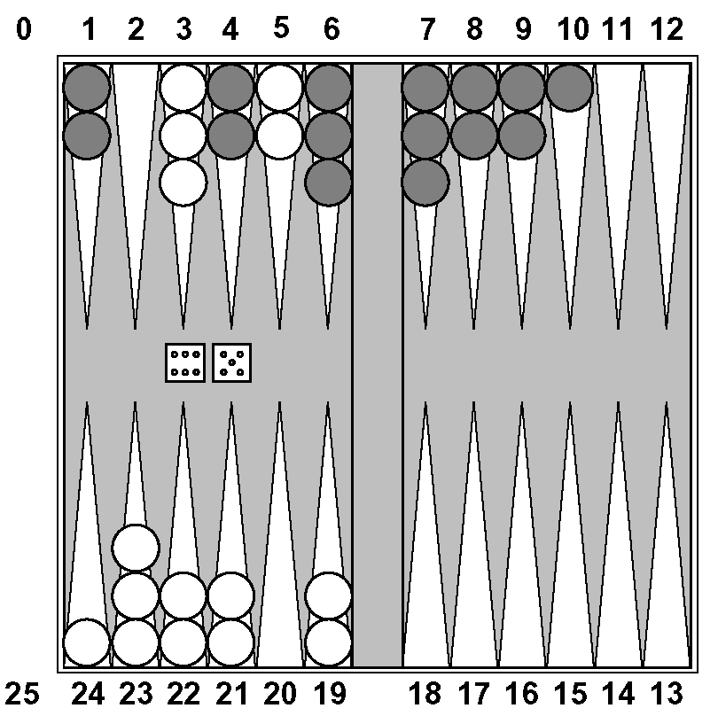
Nondeterministic games: backgammon

Slide 31
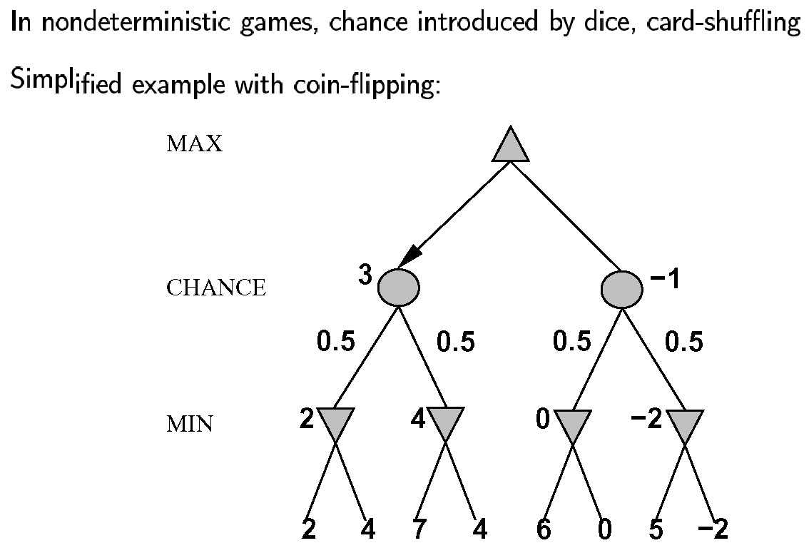
Nondeterministic games in general

Slide 32
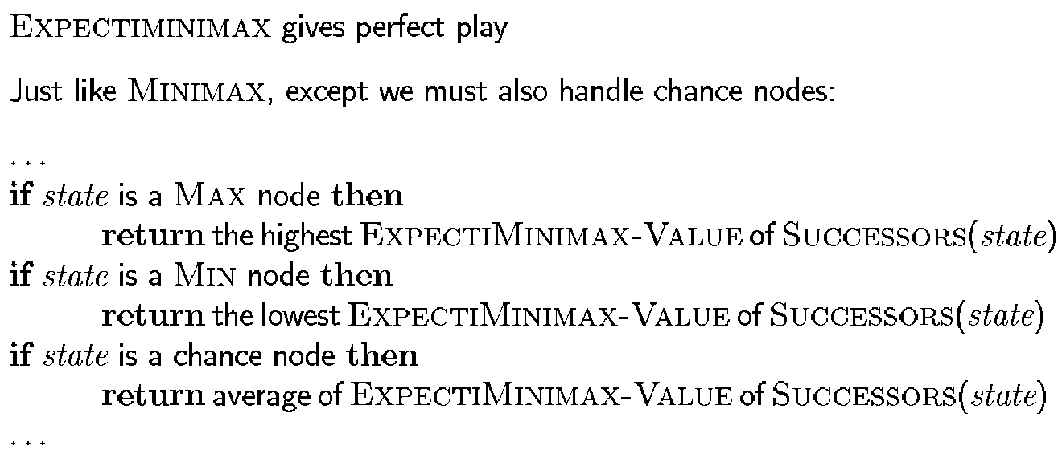
Algorithm for nondeterministic games

Slide 33
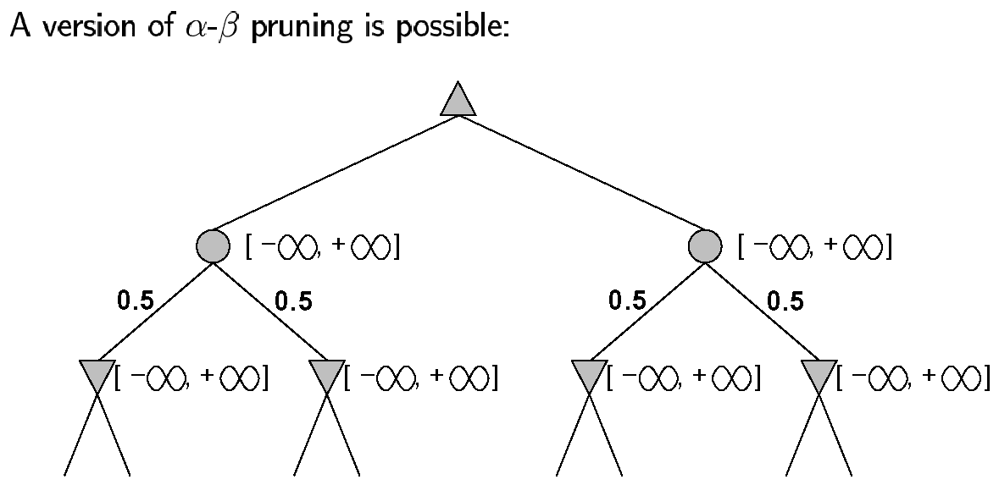
Pruning in nondeterministic game trees

Slide 34
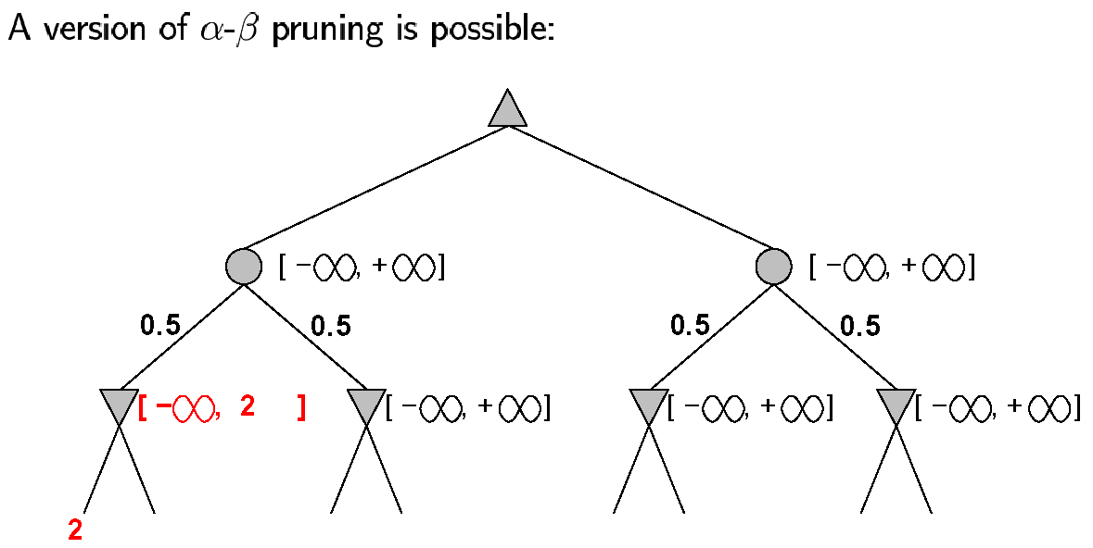
Pruning in nondeterministic game trees

Slide 35
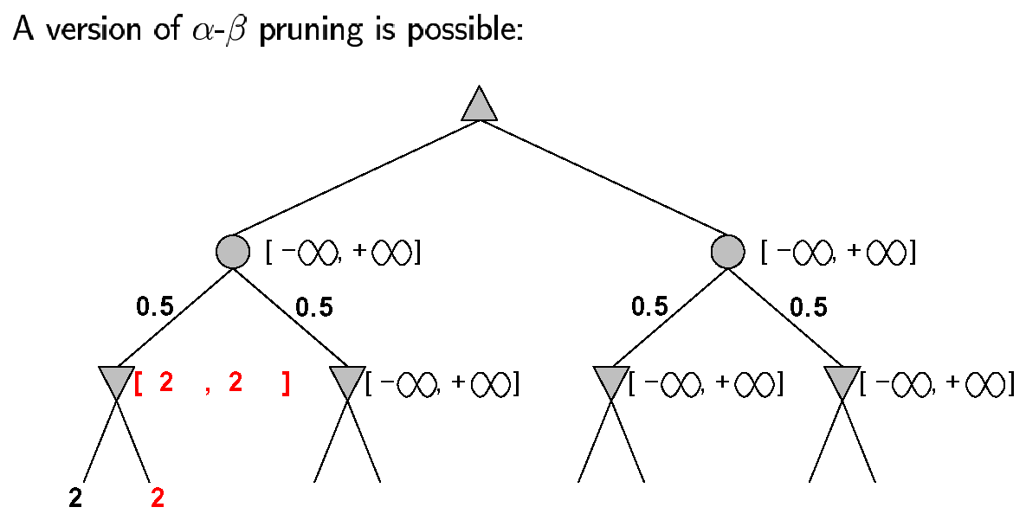
Pruning in nondeterministic game trees

Slide 36
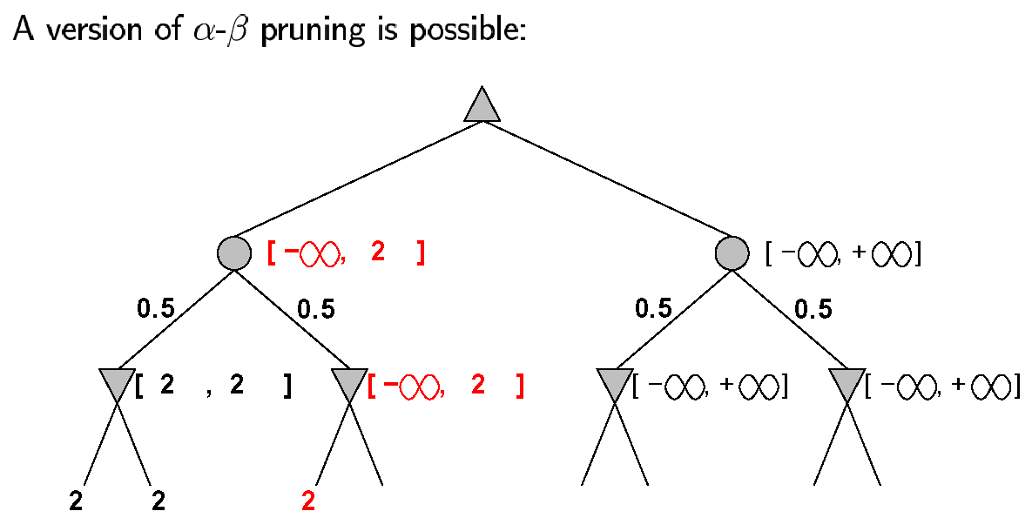
Pruning in nondeterministic game trees

Slide 37
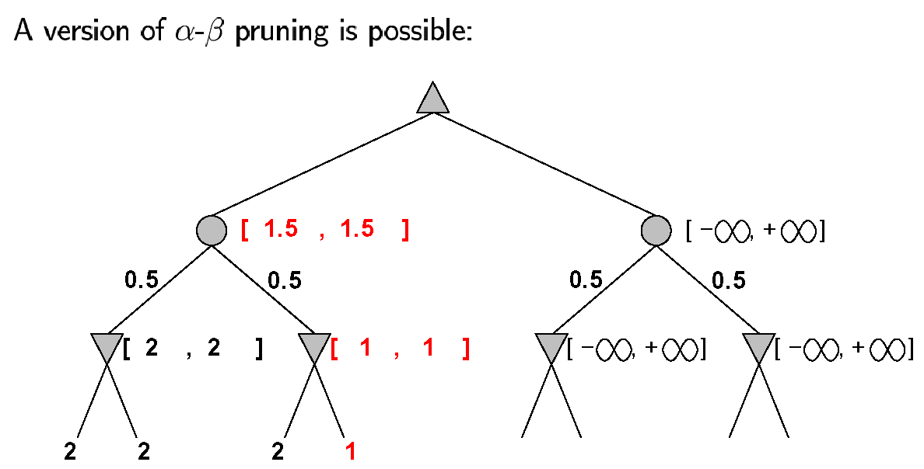
Pruning in nondeterministic game trees

Slide 38
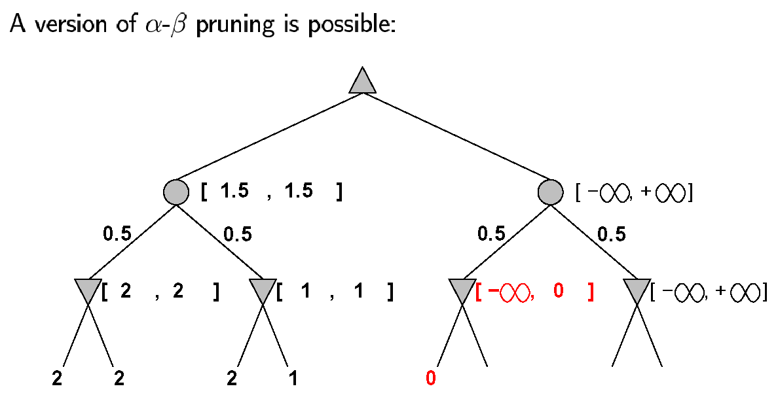
Pruning in nondeterministic game trees

Slide 39
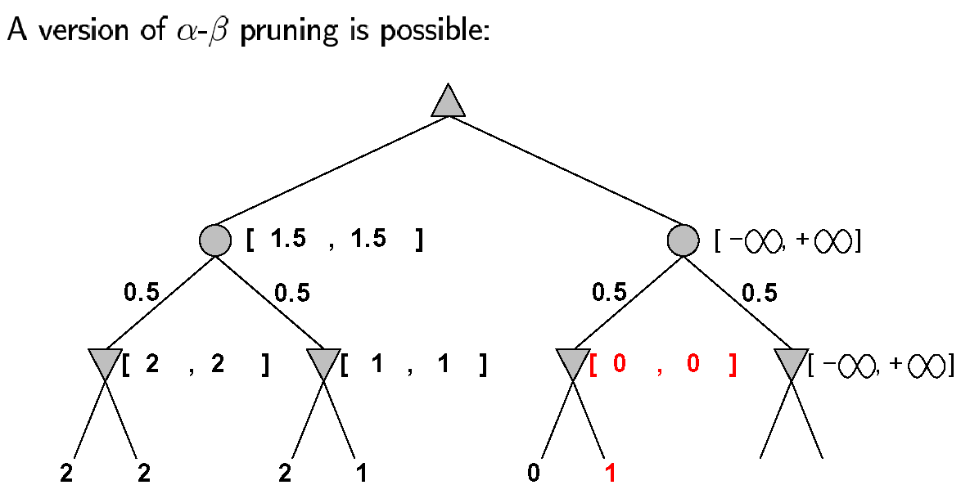
Pruning in nondeterministic game trees

Slide 40

Pruning in nondeterministic game trees

Slide 41

Pruning contd.

Slide 42

Pruning contd.

Slide 43

Pruning contd.

Slide 44

Pruning contd.

Slide 45

Pruning contd.

Slide 46

Pruning contd.

Slide 47

Nondeterministic games in practice

Slide 48

Digression: Exact values DO matter

Slide 49

Games of imperfect information

Slide 50
Solving games
Game-theoretic value of a game
The outcome, i.e., win, loss or draw, when all participants play optimally.

Slide 51
Classication of games' solutions (L.V. Allis in 1994 )
Ultra-weakly solved
the game-theoretic value of the initial position has been determined.
Weakly solved
for the initial position a strategy has been determined to achieve the game-theoretic value against any opponent.
The strategy must be efficient and practical in terms of resource usage.
Strongly solved:
a strategy has been determined for all legal positions.

Slide 52
Complexity issue
State-space complexity of a game
the number of all legal positions in a game.
Game-tree (or decision) complexity of a game
the number of all leaf nodes in a solution search tree.
A solution search tree is a tree where the game-theoretic value of the root position can be decided.

Slide 53
Complexity for Tic-Tac-Toe
Upper bound ⇒legal positions ⇒rotation and reflections
State space
3⁹ (19683)⇒5478 ⇒765
Game tree size
9! ⇒255168 ⇒26830

Slide 54
Fair game
A fair game
the game-theoretic value is draw and both players have roughly an equal probability on making a mistake

Slide 55

A double dichotomy of the game space

Slide 56
Games | Log(state-space) | Log(game tree size
Nine Men's Morris | 10 | 12
Connect-four | 14 | 21
Checkers | 21 | 31
Othello | 28 | 58
Chess | 46 | 123
Chinese chess | 48 | 150
Hex(11x11) | 57 | 98
Shogi | 71 | 226
Renju(15x15) | 105 | 70
Go-Moku(15x15) | 105 | 70
Go(19x19) | 172 | 360

Slide 57

Games in practice
Predictions for 2010 at 2000(Herik et.al.)

Slide 58

Games in practice
Status

Slide 59
THE END.

